Slide 1
BGC IT · AI HACKATHON
Time Tracking Build Challenge
Kickoff
Today. A real BGC problem. Let’s build.
Thursday, August 27th, 2026

Slide 2
What to expect this morning…
1
The shape of the day — how today runs, start to finish.
2
Why we’re here and what we’re building.
3
The Foundation everyone builds — and your stretch area.
4
Your team, your roles, your coaches — and how to run your day.
5
The data rules — what you can and can’t use.
6
Demos, judging, and what we expect — then questions.
CONFIDENTIAL – INTERNAL USE ONLY
Time Tracking Build Challenge · 2

Slide 3
Join the main Hackathon Team Meeting
What will the day look like?
In Your Teams
8:30
9:00
9:30
Midday
3:30
4:00
5:30
0
1
2
3
4
5
6
Kickoff &
Team Assignments
Join Your Teams
& Assign Roles
Build
Lunch Break
Stop &
Prep Demos
Demos +
Judging
Wrap Up
Cameras Required.
A Coach will pop in and out of your Team throughout the day to check-in and observe.
Stuck – Send an email to Corinne, Paul, Rosna.
CONFIDENTIAL – INTERNAL USE ONLY
Time Tracking Build Challenge · 13

Slide 4
Why we’re here today…
1
Build something useful
A working slice of a system BGC IT actually needs — not an exercise.
2
Build real AI skills
Hands-on practice using AI to design, build and test.
3
Shape what’s next
What you learn today guides where we invest in AI tools and training.
CONFIDENTIAL – INTERNAL USE ONLY
Time Tracking Build Challenge · 3

Slide 5
The challenge…
Could we internally build a Time Tracking System?
Your team builds a working piece in a day; recording a week of hours and classifying each hour as capital or operating expense.
1
Enter the week
2
Classify each hour
Hours against projects and categories
Capital (CapEx) or operating (OpEx)
CONFIDENTIAL – INTERNAL USE ONLY
Time Tracking Build Challenge · 4

Slide 6
What everyone builds: The Foundation.
1
2
A timesheet entry screen
Correct CapEx / OpEx
Log a week of hours against projects and non-project categories, in 15-minute increments, with a running total.
Each project hour classified as capital or operating, based on the task code chosen. Non-project time is operating expense.
Deliberately achievable in a day. This is the bar. Everyone hits it before anything else.
CONFIDENTIAL – INTERNAL USE ONLY
Time Tracking Build Challenge · 5

Slide 7
…then pick a Stretch Area.
1
2
3
Monthly close flow
Reporting dashboard
AI classification helper
Submit → correction window → lock the period.
Project hours vs. support hours, at a glance.
Capital vs. OpEx hours, at a glance.
Suggests CapEx/OpEx for the tricky judgment calls.
Your team picks one. How far you get is up to you — that's part of what makes it interesting.
CONFIDENTIAL – INTERNAL USE ONLY
Time Tracking Build Challenge · 6

Slide 8
Your teams are cross functional diverse teams.
1
Product Owner / Business Expert
4
QA / Demo Lead
Responsibilities: Interpret requirements, prioritize features, keep the team focused on Foundation first.
Responsibilities: Test scenarios; find defects; validate calculations; prepare demo script.
“You own correctness, not coding.”
“Make sure your team is prepared for demo time.”
2
AI Prompt Engineer
5
Scrum Master / Delivery Lead
Responsibilities: Generate code, test data, and UI mockups; refine prompts; explain AI outputs.
Responsibilities: Coordinate work; remove blockers; track milestones; manage scope; keep demo focus.
“Your job is to make the AI productive.”
“Keep the team moving, aligned, and focused on outcomes.”
3
Builder / Integrator
TEAM SETUP
Responsibilities: Assemble components; fix errors; connect screens; debug and package the demo.
6 teams
about 7 - 8 people each
“You pull it together.”
CONFIDENTIAL – INTERNAL USE ONLY
Time Tracking Build Challenge · 16

Slide 9
How to start and run your day
Your Scrum Master drives this. There is no single right answer — work the way your team works best.
1
Start with introductions
4
Don’t be afraid to work in pairs, not silos
Quick intros and a skills review, then define your roles so everyone knows how they contribute.
Double up on roles. Parallel path, pair senior with junior, or divide and conquer — whatever is best for your team and moves you forward.
“First 30 minutes, before any building.”
“Collaborate!”
2
Draft a plan up front
5
Bring everyone along
Brainstorm, agree your approach and your stack, and decide who validates the Foundation and who chases the stretch goal.
Share screens so the team can watch the build happen, and encourage experimentation throughout the day.
“Watching is how people learn.”
“A rough plan beats no plan.”
3
Use your licenses
6
Check in hourly
Everyone has at least one paid AI license — use it. Without a license you can still prompt, test, validate and document.
Run short hourly scrums, track milestones and progress in Teams, and raise blockers early — don’t wait until the end.
“There is a job for every person.”
“Raise blockers early to Corinne, Paul and Rosna in email.”
CONFIDENTIAL – INTERNAL USE ONLY
Time Tracking Build Challenge · 9

Slide 10
Coaches, support, and where everything lives
You are not on your own today — ask early rather than staying stuck.
Where to find everything
Stuck – Send an email to Corinne, Paul, Rosna
All posted in the main Teams channel and will be sent in email:
1
Hackathon Data
Partner list, project list, coding categories and fiscal calendars.
2
The Requirements
Six coaches will rotate through the team channels to check in and observe. They guide; they don’t build for you.
A comprehensive requirements document.
3
This Deck
See the coach schedule, check out the timeline again, review the team roles.
4
Demo Schedule
Demos start 4:00, everyone attends, demo schedule posted after lunch.
CONFIDENTIAL – INTERNAL USE ONLY
Time Tracking Build Challenge · 12

Slide 11
What data will you need?
Use only the provided Hackathon Data during the challenge – if you think you need something more – ask!
Hackathon Data will be provided
HEADS UP
You will receive:
Keep real data out of AI tools
1
Partner List
A fake partner list
2
BGC Project List
Partner data and non-public company data should never be put into AI tools.
A fake BGC project list
3
Project & Non-Project Coding
Codes correlated to financial capital and expense categories
4
Fiscal Calendars
BGC fiscal FY26 and FY27 calendars
CONFIDENTIAL – INTERNAL USE ONLY
Time Tracking Build Challenge · 7

Slide 12
What you’ll be given…
1
Project Brief — the challenge, scope, and what “done” looks like.
2
Project Data Workbook — the sample data you build against.
3
Project Requirements — the Foundation everyone builds, plus the stretch areas.
4
Kick Off Deck — this deck, for the run of day, rules, and judging criteria.
5
Python Server Instructions — how to set up and run your local server environment…if you want to use this.
CONFIDENTIAL – INTERNAL USE ONLY
Time Tracking Build Challenge · 12

Slide 13
How demos run and how you’ll be judged
1
Does it work?
At 4:00 — the demo
It runs in the demo and does what the Foundation requires.
Join the main meeting channel at 4PM.
5-minute working demo.
Rough is fine — working beats polished.
Demo order will be posted in the main channel.
2
Meets the requirements
Your build matches the ask, and meets the requirements.
Then four questions…
How would you describe your approach?
How did you use AI?
Where did it excel; where did it have challenges?
What would you need to finish it — tools, time, skills, or access?
3
Used AI meaningfully
Your team’s use of AI throughout the day.
CONFIDENTIAL – INTERNAL USE ONLY
Time Tracking Build Challenge · 14

Slide 14
What we expect from you today
1
Stay with us for the full day — cameras on.
2
Build the Foundation first, before any stretch.
3
Use AI throughout … that’s the whole point.
4
Demo live at 4:00, even if it’s rough.
5
Be a good teammate.
6
Complete the post Hackathon survey to share feedback and lessons learned
CONFIDENTIAL – INTERNAL USE ONLY
Time Tracking Build Challenge · 15

Slide 15
Your teams and channels
Six teams, about seven people each. Find your name, join your channel, and start with quick introductions.
Team | Members | Coaches
Blue | Aidan Hendershot, Annette Adams, Bill Hart, Darren Weaver, Jaykumar Ahir, Patricia Mckinney, Rob Peel | Coaches will float across all teams throughout the day. Curtis Wiggins Kevin Holland Eddie Collins Suzanne Lowrance Tom Pile Akshatha Aralihalli
Green | Chris Van Tuyl, Delaney Essman, Eric Brooks, Jennifer Shires, Jonathan Cummins, Matthew Herod, Shelly Simmons
Orange | Caitlin Hedrick, Chris Clark, Glenn Moore, Josh Smith, Joel Turrentine, Quinn Gregory, Robert Campbell, Scott Bates
Purple | Bruce Bates, Jeff McDonald, Matt Sundholm, Suvadeep Bhattacharya, Ganapathi Raju, Tamie Haskins, Todd Hensley, Wes Russ
Red | Bikas Bista, Chris Rolling, Colby Bragg, Eric Chandler, Guillermo Stortoni, Laurie Grimmett, Robert Gray
Yellow | Brian Seib, Brock Taylor, Izayah McCardell, Jake Johnson, JoAnn Clamp, Miriam Jaimes, Nick Parrish
Scrum Masters – you know who you are! Jump in…help your team start organizing.
CONFIDENTIAL – INTERNAL USE ONLY
Time Tracking Build Challenge · 8

Slide 16
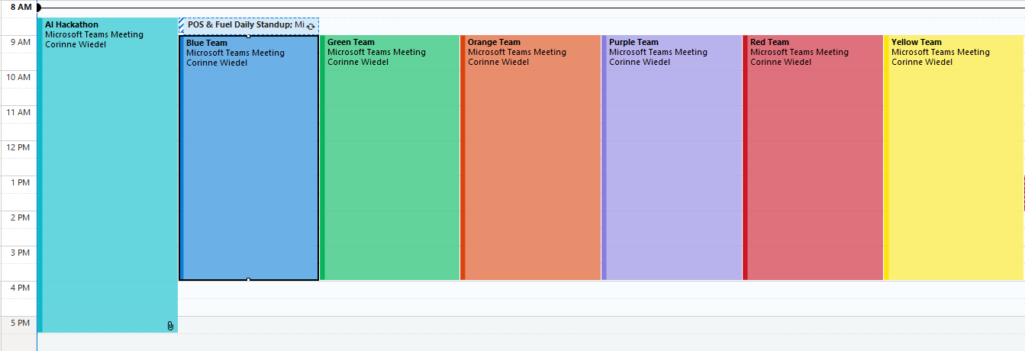
Your teams and channels
When you join your team – double check everyone has joined!
Reminder – everyone drops from their hackathon team at 4PM and joins the main meeting to see everyone’s demos!
CONFIDENTIAL – INTERNAL USE ONLY
Time Tracking Build Challenge · 8

Slide 17
Questions — then let’s go.
Build the Foundation. Pick your stretch. Show us what we can do with AI.
Head to your team channel now. Introductions and roles first — then start building.

